Slide 1

Smart swimming pool
Matteo Mugnai, Filippo Puccini

Slide 2
Introduction
Use case: Smart IoT and telemetry system for the control and management of a swimming pool
Main goal: simulate a LLN composed by sensors and actuators capable of monitor and automatically react to changes in environmental conditions through a control system handled by a JAVA application

Slide 3









IoT devices
Sensors (MQTT)
Presence (bool)
Water temperature (int, °C)
Water level (int, %)
Chlorine level (int, %)
Actuators (CoAP)
Lights (ON|OFF)
Heating system (INC|DEC|OFF)
Water pump (INC|DEC|OFF)
Chlorine dispenser (ON|OFF)

Slide 4
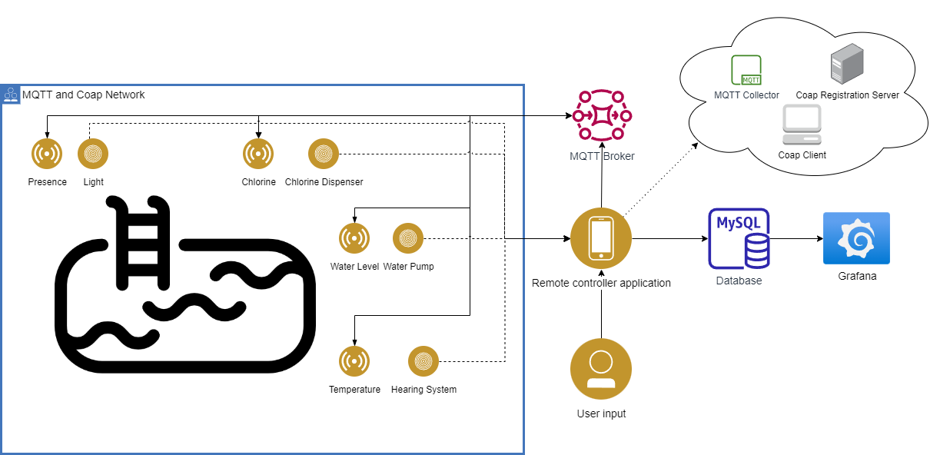
System architecture

Slide 5
CoAP
Light
Heating system
CLIENT: Cloud App
SERVER: IoT actuator
/light/switch (mode=[‘ON’, ’OFF’])
/light/color (color=[‘r’, ’g’, ’b’])
→PUT: method to change the status or the color of lights
CLIENT: Cloud App
SERVER: IoT actuator
/chlorine_dispenser/switch (mode=[‘ON’, ’OFF’])
→PUT: method to change the status of chlorine dispenser
CLIENT: Cloud App
SERVER: IoT actuator
/heating_system/switch (mode=[‘INC’, ’DEC’, ’OFF’])
→PUT: method to change the status of heating system
CLIENT: Cloud App
SERVER: IoT actuator
/water_pump/switch (mode=[‘INC’, ’DEC’, ’OFF’])
→PUT: method to change the status of water pump
Chlorine dispenser
Water pump
Actuator registration
CLIENT: IoT actuator
SERVER: Cloud App
/registration
POST: method to add a new actuators in the database
DELETE: method to delete an actuator from database

Slide 6
MQTT
Measurements
Sensor notification
PUB → IoT device
SUB → Cloud App
Presence (topic = ‘presence’)
Chlorine (topic = ‘chlorine’)
Temperature (topic = ‘temperature’)
Water_level (topic = ‘water-level’)
These topics are used to periodically (every 1s) send to cloud app the values sensed by devices
PUB → Cloud App
SUB → IoT device
Presence (topic = ‘light-command’)
Chlorine (topic = ‘chlorine-command’)
Temperature (topic = ‘temperature-command’)
Water_level (topic = ‘water-level-command’)
These topics are used to inform a specific sensor that an actuator has been activated (to trigger a change in sintetic data generation from ficticious sensors)

Slide 7

Data Encoding (JSON)
{"nodeId": "001",
"height": "50"}
{"nodeId": “002",
"presence": “true"}
{"nodeId": “003",
"temperature": “25"}
{"nodeId": “004",
"chloirne": “75"}
WaterLevel →
All sensors return the data they have collected in JSON format:
JSON is more flexible and less verbose than XML
JSON is lighter and faster to process than XML
Our application does not process critical data
Presence →
Temperature →
Chlorine →

Slide 8
Cloud application
Implemented in JAVA using Californium and Paho library
Stores data coming from sensors in a MySQL DB
Stores all CoAP messages in a log file
Allow user interaction through a simple command interface:
Get last measurement sensed
Manually intervention on actuators (ON/OFF or INC/DEC)
Set new thresholds (lowerBound and upperBound) in which a specific measure must stay
Handles a control logic to regulate actuators when it’s necessary:
Trigger activation and deactivation of actuators when values are not in the correct range

Slide 9

Control logic
Temperature:
When the average of the last 5 samples received is above/below a threshold we send a CoAP message to activate heating system in ‘DEC’/‘INC’ mode
WaterLevel and ChlorineLevel:
When we detect three consecutive samples above/below a certain threshold we send a CoAP message to activate water pump (‘INC’ / ’DEC’) or chlorine dispenser (‘ON’)
Presence:
When we receive a ‘true’ value we send a CoAP message to switch ‘ON’ lights
Actuators remain active until the level of the associated measure come back to the exact mean between lowerBound and upperBound

Slide 10


Buttons & LEDS
Buttons have been used on actuators:
-HeatingSystem
-WaterPump
-ChlorineDispenser
Press button to switch ON/OFF the relative actuator
Leds have been used on actuators:
-HeatingSystem
-WaterPump
-ChlorineDispenser
-Light → led ON indicates the current colour of the light (‘GREEN’, ‘RED’, ‘YELLOW’)
‘GREEN’ led means actuator ON, ‘RED’ led means actuator OFF

Slide 11
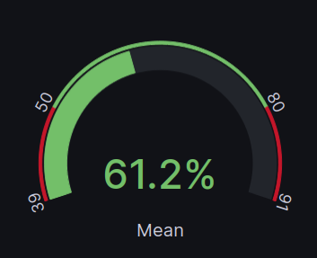
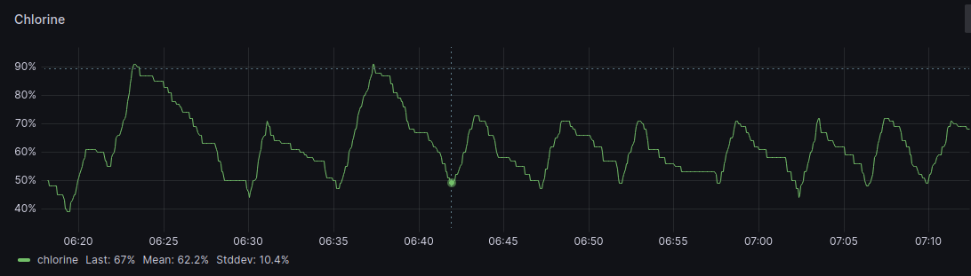
Grafana
Lb: 50 Ub: 90
Ub
(Ub+Lb)/2
Pressed button manually
Trigger regulates level automatically

Slide 12
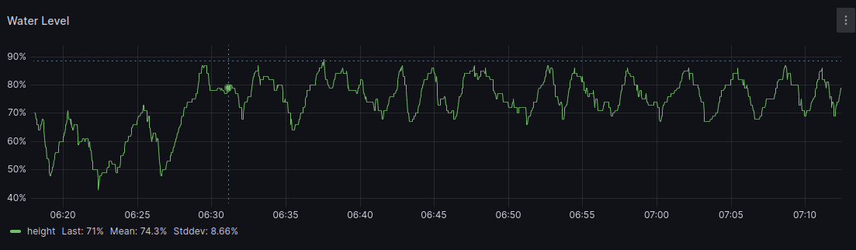
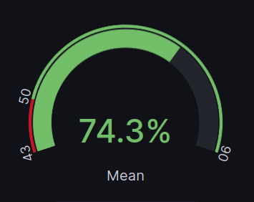
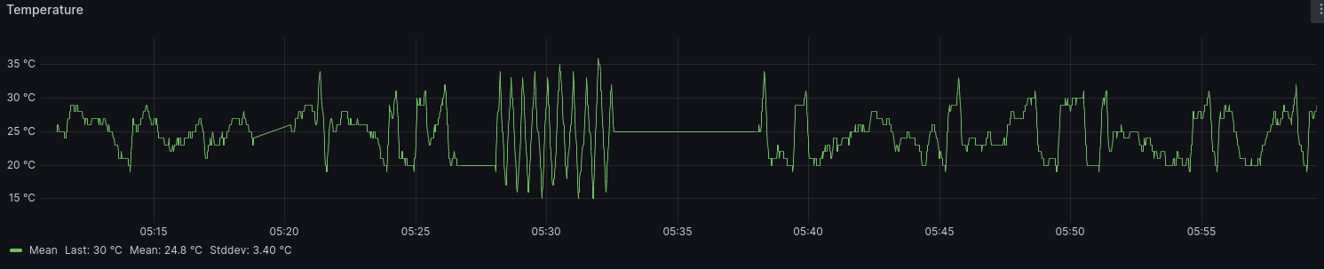
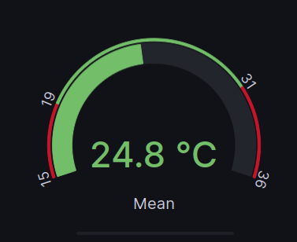
Grafana

